Slide 1
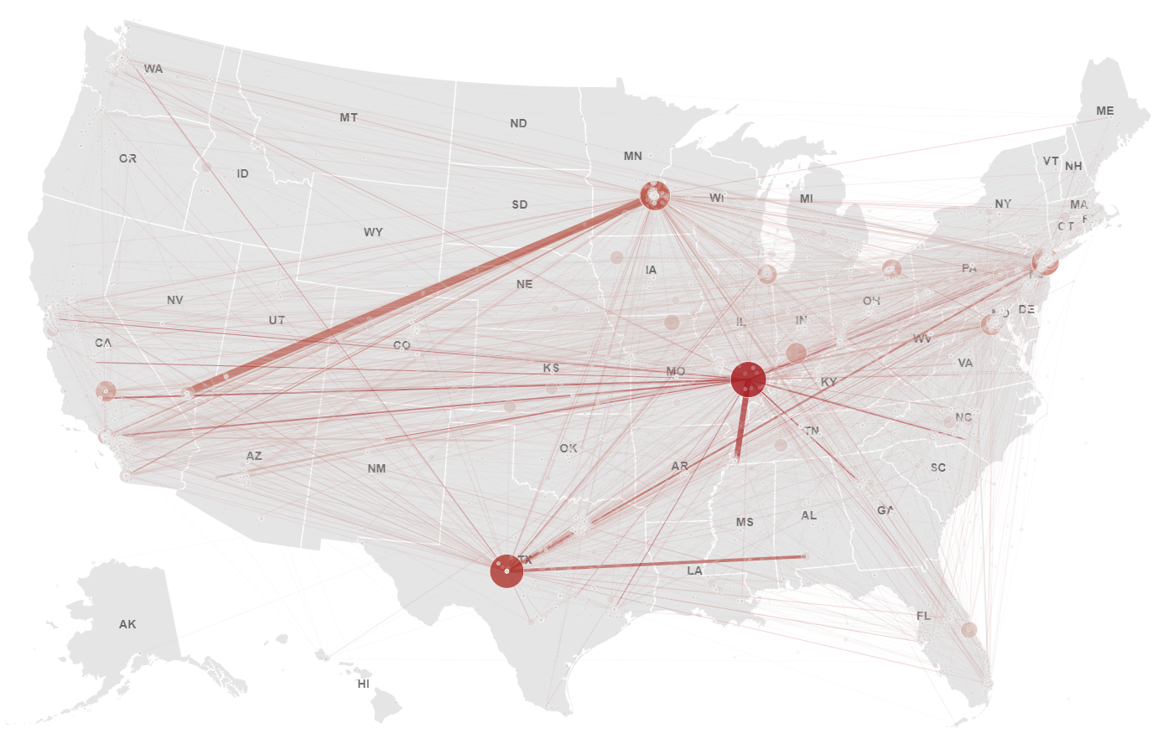



#Hashtags as a Means for Political Action
Exploring the Impact of Hashtag Activism on Political Processes Using Geolocated Social Media Posts Data
Leonardo Nicoletti

Slide 2
Overview
Research problem and research objectives
Methods and experimental design
Key results
Research impact
Ethical considerations

Slide 3

Problem Introduction
Hashtag activism
Notes:
Today, # Hashtag Activism, the use of Twitter's hashtags to do activism online → crucial strategy for activists trying to influence social change
Over the past 2 decades there has been a lots of research in this field,

Slide 4
Problem Introduction
Hashtag activism
social movements
Notes:
Today, # Hashtag Activism, the use of Twitter's hashtags to do activism online → crucial strategy for activists trying to influence social change
Over the past 2 decades there has been a lots of research in this field,
Importance for shaping the structure of social movements
Importance for shaping political discourse and narratives

Slide 5
Problem Introduction
Hashtag activism
political discourse
social movements
Notes:
Today, # Hashtag Activism, the use of Twitter's hashtags to do activism online → crucial strategy for activists trying to influence social change
Over the past 2 decades there has been a lots of research in this field,
Importance for shaping the structure of social movements
Importance for shaping political discourse and narratives

Slide 6
Problem Introduction
Hashtag activism
political discourse
social movements
recent examples:
#JusticeForGeorgeFloyd
#ColombiaResiste
Notes:
Today, # Hashtag Activism, the use of Twitter's hashtags to do activism online → crucial strategy for activists trying to influence social change
Over the past 2 decades there has been a lots of research in this field,
Importance for shaping the structure of social movements
Importance for shaping political discourse and narratives
Last year, we’ve all seen how one hashtag, #justiceforgeorgefloyd, has led to millions of people protesting in the US and worldwide and challenge the very existence of a long time institution (police). And currently, the same strategy is being used by activists in Colombia to protest increased taxes, corruption, and now various forms of state sanctioned violence on civilians

Slide 7
Theoretical Level
Hashtag activism
Political Processes
(i.e. physical protest, voter behaviour, legislature etc.)
Notes:
Theoretical and anecdotal evidence that #activism can have real political consequences BUT

Slide 8
Theoretical Level
Hashtag activism
Political Processes
(i.e. political discourse, physical protest, voter behaviour, legislature etc.)
But… Empirical Evidence?
Notes:
Lack of empirical evidence supporting this understanding through quantitative analysis

Slide 9

Hashtag activism
?
?
Physical Protest
Notes:
Existing research:
impact of #activism on physical protest: disagreement

Slide 10

Hashtag activism
?
?
?
?
Physical Protest
Legislative change
Notes:
Existing research:
impact of #activism on physical protest: disagreement
impact of #activism on legislative action: barely exists

Slide 11

Hashtag activism
?
?
?
?
Physical Protest
Legislative change
Notes:
Existing research:
impact of #activism on physical protest: disagreement
impact of #activism on legislative action: barely exists
Our understanding of the spatial relationships between these processes is even more limited
Unresolved questions:
can social media activity in a specific geographical area influence legislative action within that same area?
can social media activity in a specific geographical area be used to predict where and when physical protests will take place?

Slide 12
Hashtag activism
?
?
?
?
Physical Protest
Legislative change
geolocated social media data
relationship between hashtag activism and political processes
Notes:
More generally, a thorough understanding of how Geo-located data can help us understand the spatial relationship between hashtag activism and political processes is lacking

Slide 13
Research Question(s)
What are the political impacts of location-based hashtag activism during and after social movements?
Notes:
So, this is precisely the objective of my research: to build on top of the theoretical understanding that (networked) social movements can have political consequences, and to leverage geolocated social media data to provide an evidence based understanding of the political implications of hashtag activism.

Slide 14
Research Question(s)
SQ1. What is the relationship between location-based hashtag activism and physical protest activity?
What are the political impacts of location-based hashtag activism during and after social movements?
SQ2. What is the relationship between location-based hashtag activism and legislative action?
Notes:
So, this is precisely the objective of my research: to build on top of the theoretical understanding that (networked) social movements can have political consequences, and to leverage geolocated social media data to provide an evidence based understanding of the political implications of hashtag activism. More specifically, this research focuses on the impacts of hashtag activism on two political processes: physical protest, and legislative action

Slide 15
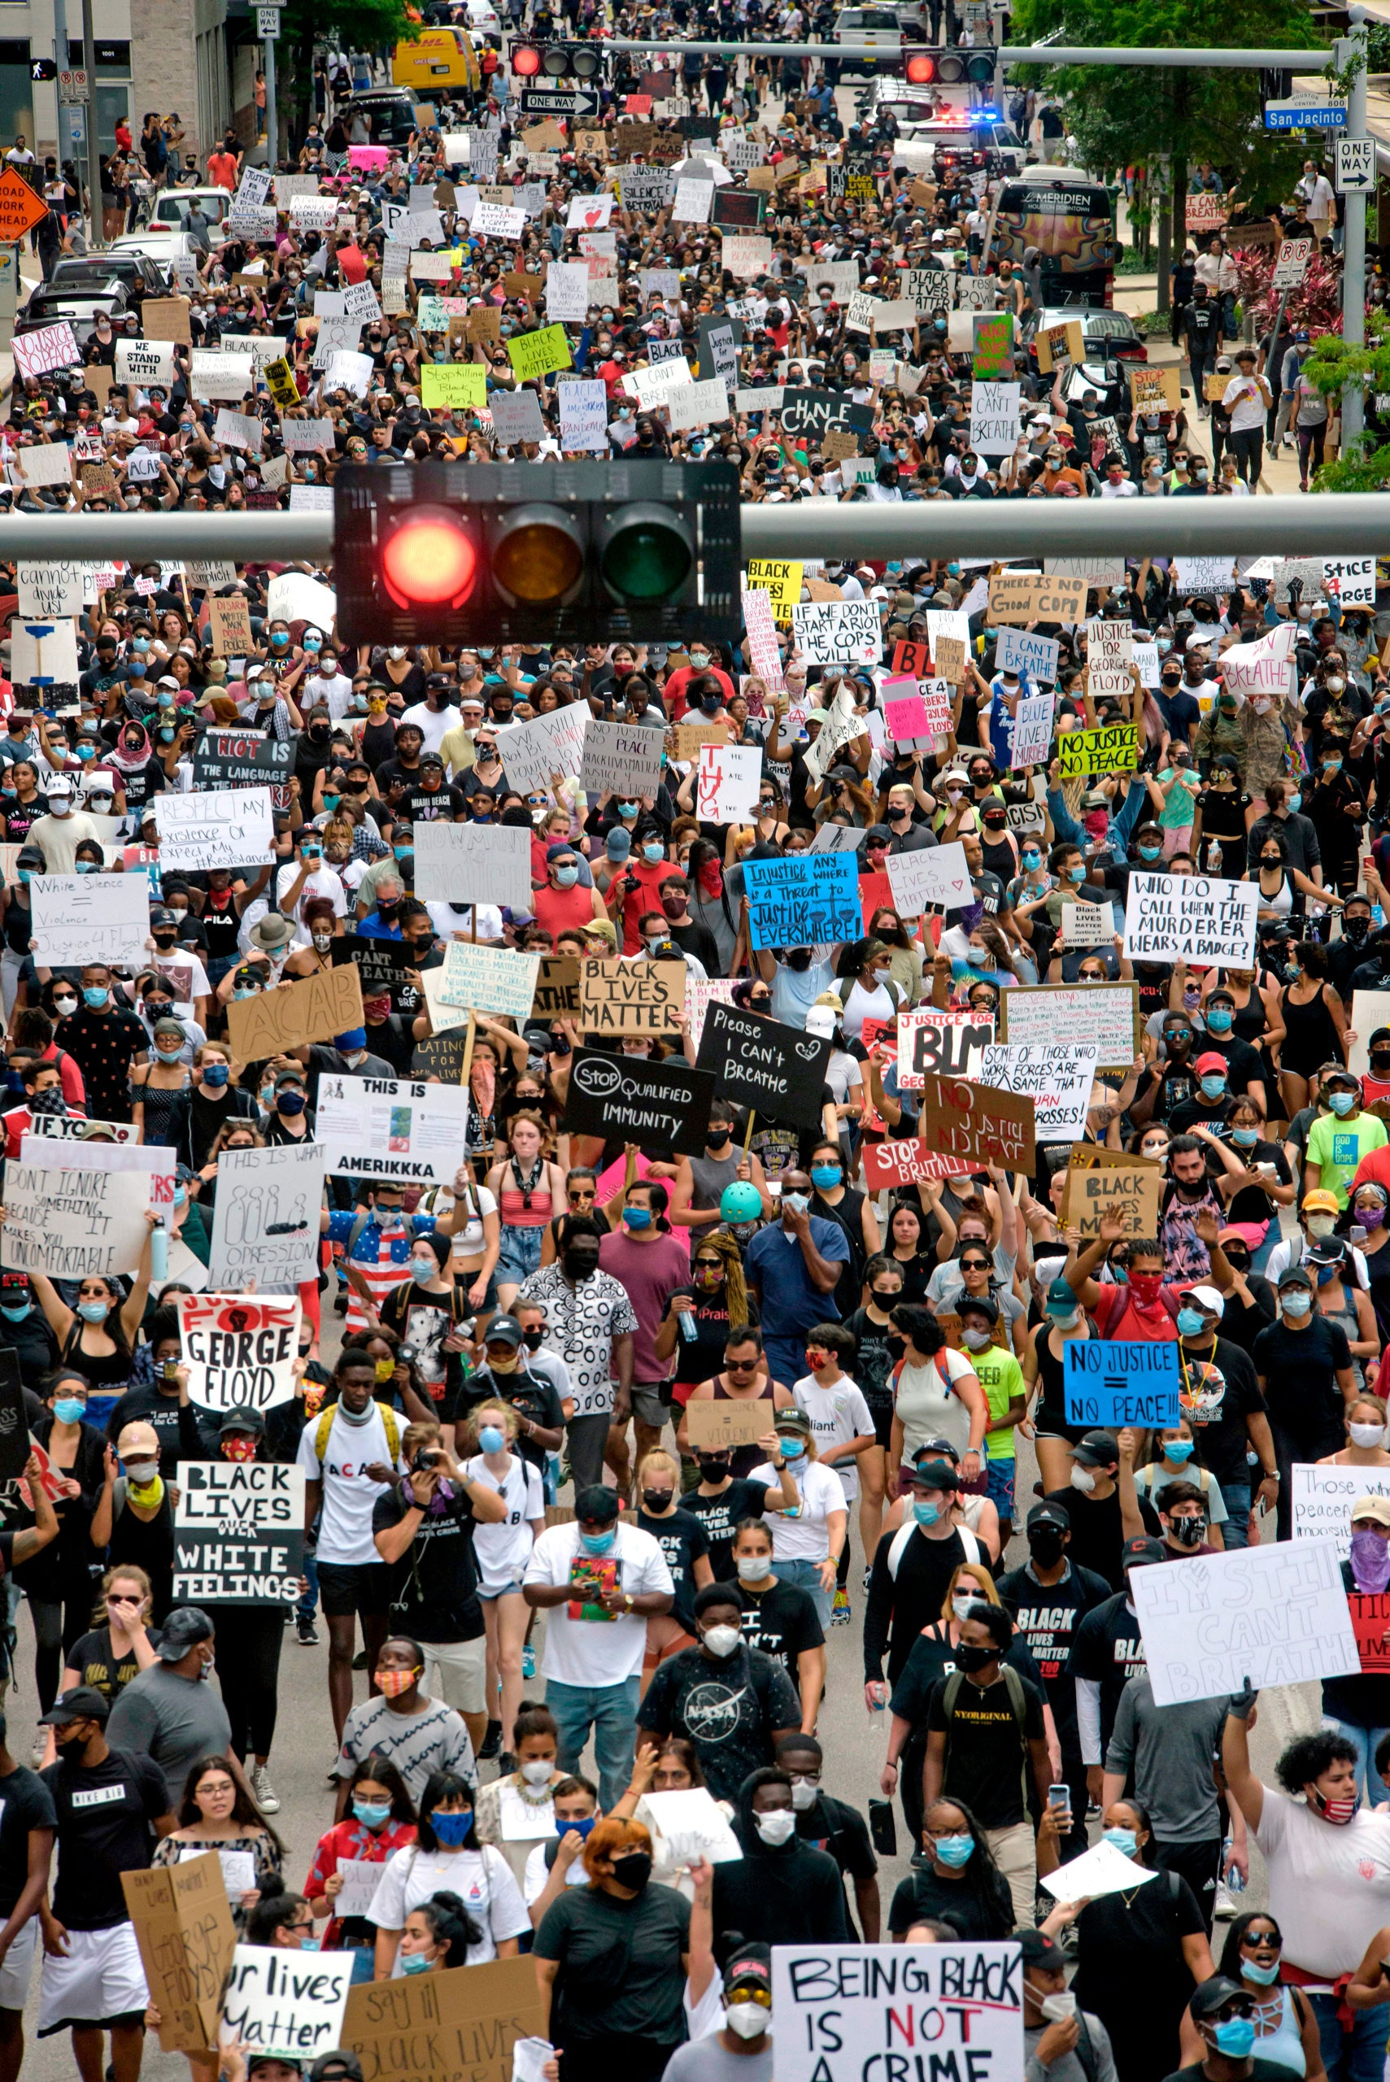
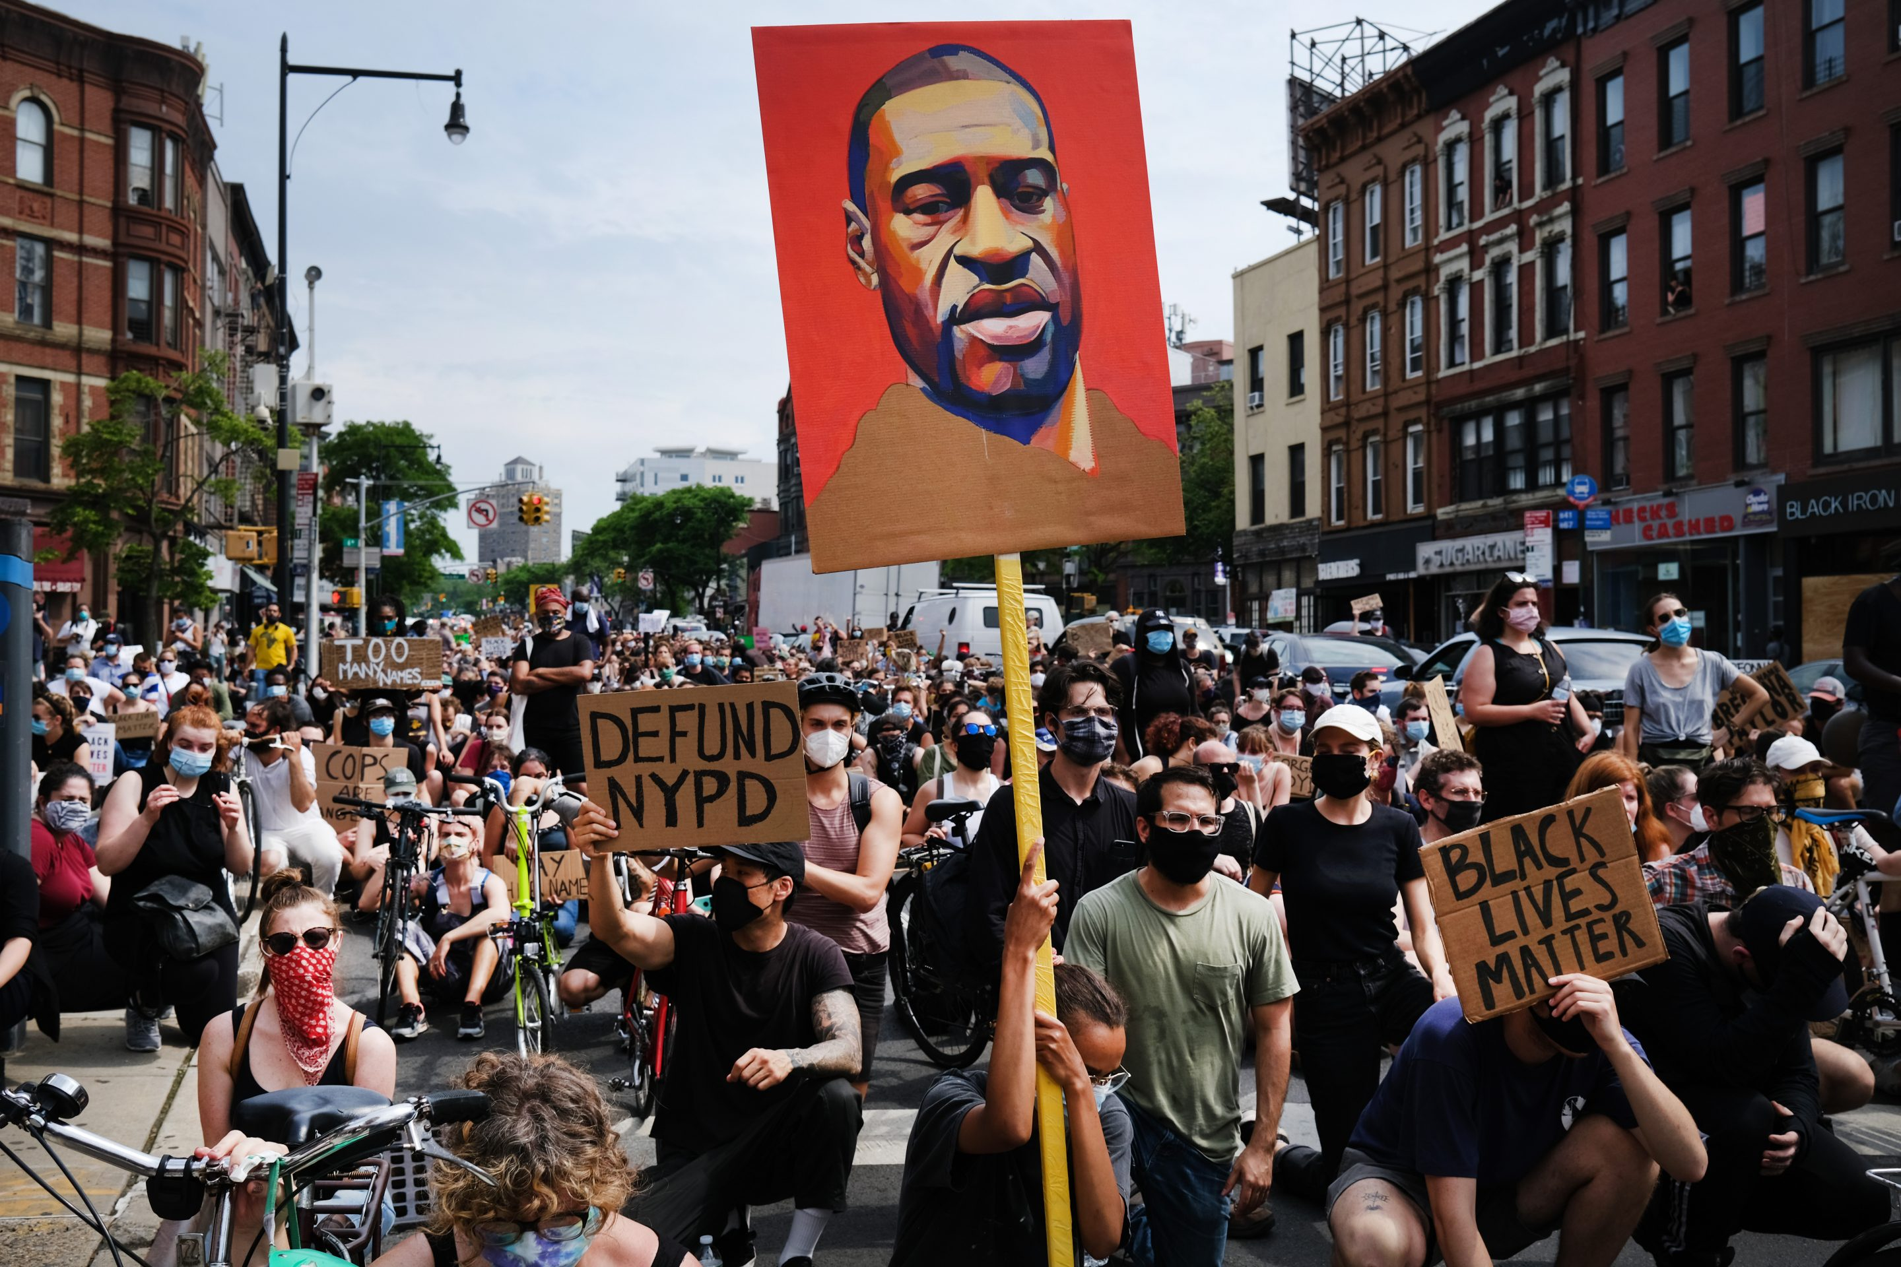
Case Study
Justice For George Floyd
5 data-sets
geo-located Twitter data from Twitter API
geo-located protest data from ACLED
data on legislatives responses to policing from NCSL
data on 2016/2020 county/precinct level election results
2020 census demographic data
Data Science approach
Web scraping
Geospatial data analysis
Network Analysis
ML (classification, regression, clustering)
Notes:
How am I doing this?
First, I am using the social media movement #JusticeForGeorgeFloyd of last summer as a case study to drive this research
the social significance of the #JusticeForGeorgeFloyd social movement, the intense use of social media during the movement, its geographic coverage in terms of physical protest, and the still-ongoing political activity related to the movement make this case highly relevant for the study of the political implications of hashtag activism.

Slide 16
Methods and Experimental design
Data Sources
US Census Bureau
ACLED
Twitter API v2
NCSL
Web scraping
Data Collection
2016 county shapes and demographics
Geo-located social media posts and geo-located physical protests
State level legislative responses to policing
Notes:
Ok so lets look at the experimental design for this research
I use 5 data-sets
1M geo-located tweets data from Twitter API
geo-located protest data from ACLED (the Armed Conflict Location & Event Data Project)
data on legislatives responses to policing from NCSL (National Council for State Legislatures)→ currently trying to find a more granular dataset
2020 census demographic data

Slide 17
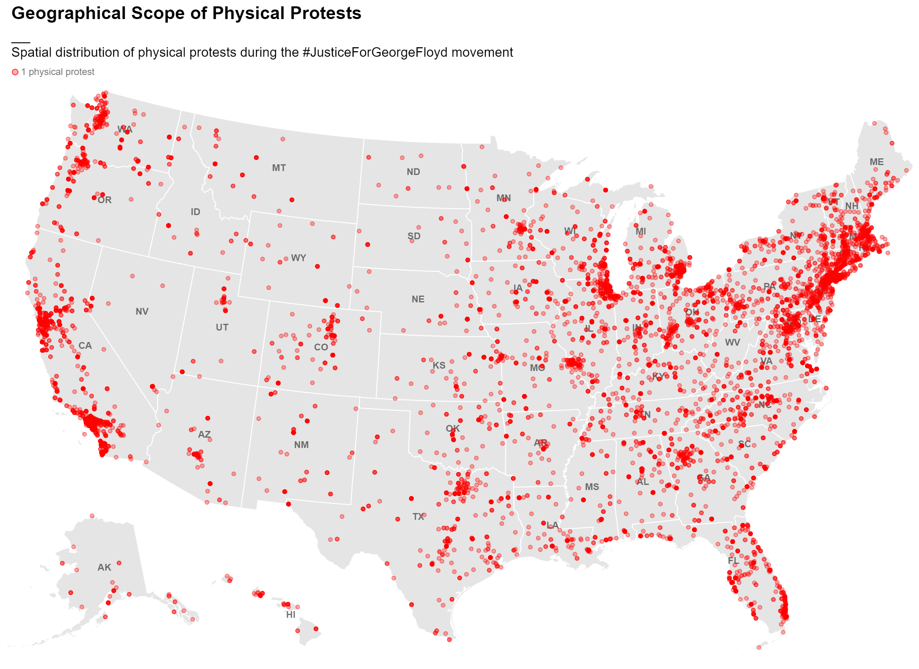
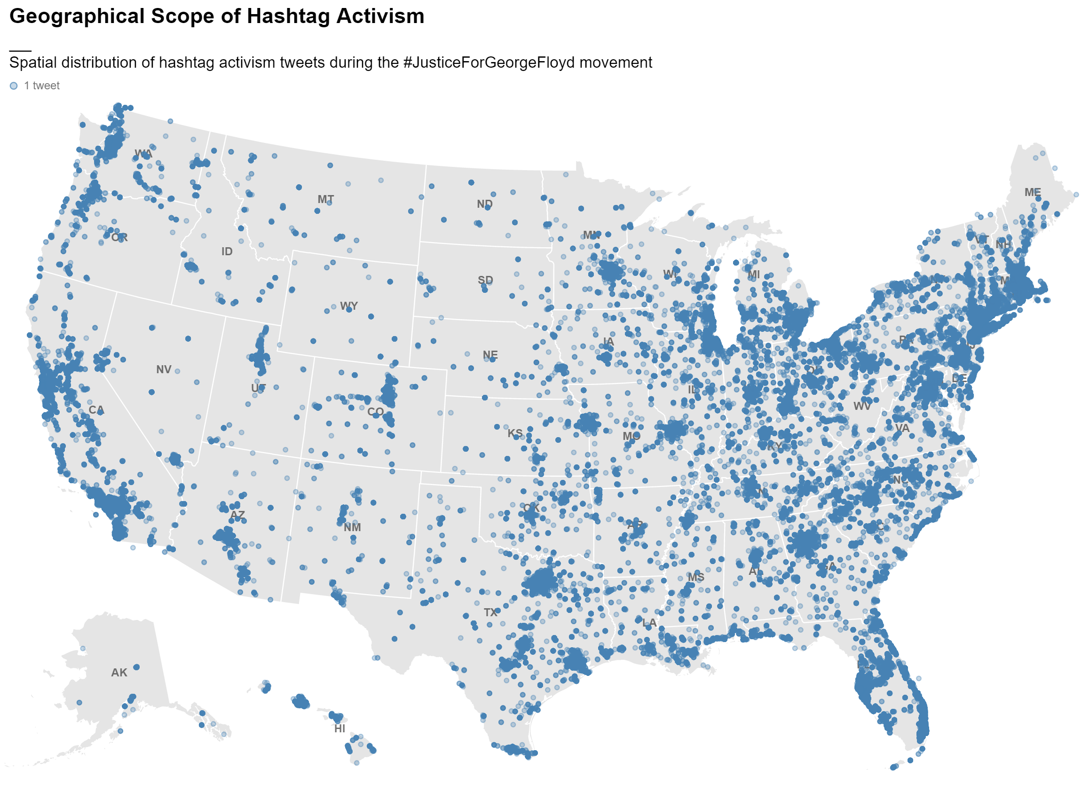
Methods and Experimental design
Data Sources
US Census Bureau
ACLED
Twitter API v2
NCSL
Web scraping
Data Collection
2016 county shapes and demographics
Geo-located social media posts and geo-located physical protests
State level legislative responses to policing
• 1 physical protest
• 1 social movement tweet
Notes:
The two primary data-sets for this research, geolocated tweets, and geolocated physical protests, are open source and available for the whole world. Which makes it possible to repeat this study for different social movements in different parts of the world.

Slide 18
Methods and Experimental design
Problem specific dimensions of #activism and physical protest
Time-dependence
Location-dependence
Relationships
Dynamicity
Notes:
Second, the task of quantifying the impacts of location-based hashtag activism on physical protest and legislative action requires an experimental design that takes into consideration key problem-specific dimensions. Each of hashtag activism, physical protest, and legislative action describe complex societal mechanisms that are (a) time-dependent (i.e. they may occur differently at specific times), (b) location-dependent (i.e. they may occur differently at specific geographical locations) and (c) dynamic (i.e. their occurrence may evolve across time and space).
So, appropriate quantitative methods must be selected to measure the relationships between #activism and protest while at the same time account for the temporal, spatial, and evolving nature of these processes.

Slide 19
Methods and Experimental design
Data Sources
US Census Bureau
ACLED
Twitter API v2
NCSL
Web scraping
Data Collection
2016 county shapes and demographics
Geo-located social media posts and geo-located physical protests
State level legislative responses to policing
Data Preprocessing
Data aggregated by county
(raw count, population normalized count)
Data aggregated by day (count)
Data aggregated by state (number of legislative responses)
TIME
Time series analysis + forecasting
Correlated time series analysis
TLCC + Granger causality
Multivariate time-series forecasting (LSTM, VAR)
Notes:
Thus, the first method chosen to address these analytical problems is Time Series Analysis, to extract temporal patterns, combined with Machine Learning techniques for Time Series Forecasting
In order to address each subquestion of this research we need to understand how instances of hashtag activism over time relate to past, present, and future rates of physical protest activity and legislative action. Additionally, we need to understand if temporal information relating to hashtag activism can provide useful insight regarding future instances of physical protest and legislative action.

Slide 20
Methods and Experimental design
Data Sources
US Census Bureau
ACLED
Twitter API v2
NCSL
Web scraping
Data Collection
2016 county shapes and demographics
Geo-located social media posts and geo-located physical protests
State level legislative responses to policing
Data Preprocessing
Data aggregated by county
(raw count, population normalized count)
Data aggregated by day (count)
Data aggregated by state (number of legislative responses)
TIME
Time series modelling
Correlated time series analysis
TLCC + Granger causality
Multivariate time-series forecasting (LSTM, VAR)
RELATION
Regression Analysis
tweets vs. physical protests
tweets vs. legislation count
Physical protest vs. legislation count
Notes:
The second modelling technique is regression analysis
in order to quantify the impacts of hashtag activism on physical protest activity and legislative action, we must establish statistical relationships between these three processes and measure how these changeover time and across space.

Slide 21
Methods and Experimental design
Data Sources
US Census Bureau
ACLED
Twitter API v2
NCSL
Web scraping
Data Collection
2016 county shapes and demographics
Geo-located social media posts and geo-located physical protests
State level legislative responses to policing
SPACE
Data Preprocessing
Data aggregated by county
(raw count, population normalized count)
Data aggregated by day (count)
Data aggregated by state (number of legislative responses)
TIME
Time series analysis + forecasting
Correlated time series analysis
TLCC + Granger causality
Multivariate time-series forecasting (LSTM, VAR)
RELATION
Regression Analysis
tweets vs. physical protests
tweets vs. legislation count
Physical protest vs. legislation count
= Geospatial Analysis
Notes:
Finally, we must consider the geo-spatial characteristics of hashtag activism, physical protest, and legislative action, and quantify how these may or may not relate to each other through space. Each of these processes, and especially hashtag activism and physical protest, is not only dynamic through time: rather as time goes by it is likely to also evolve across space.
So, in order to address SQ1 and SQ2 we must combine Time Series Analysis and regression analysis, with traditional Geo-spatial Analysis in order to accurately study such interactivity that exists across the spatial and temporal dimensions.

Slide 22
#hashtag Activism and Physical Protest: Evidence from #JusticeForGeorgeFloyd
Notes:
Let’s focus on the first main outcomes of this research: What is the relationship between location-based hashtag activism and physical protest activity?
As I mentioned earlier, the study of the relationship between hashtag activism and physical protest has been inconclusive, with evidence both in support and against the existence of such a relationship. This, scholars conclude, is partly due to a lack of empirical research and the use of limited case studies. Additionally, literature within this area of research has rarely considered the geo-spatial relationships that may exist between digital and physical protests. So, in an attempt to address this knowledge gap, I’m going to share some evidence, using the JusticeForGeorgeFloyd social movement as a case study, suggesting that there is in fact a strong temporal and spatial relationship between hashtag activism and physical protest.

Slide 23
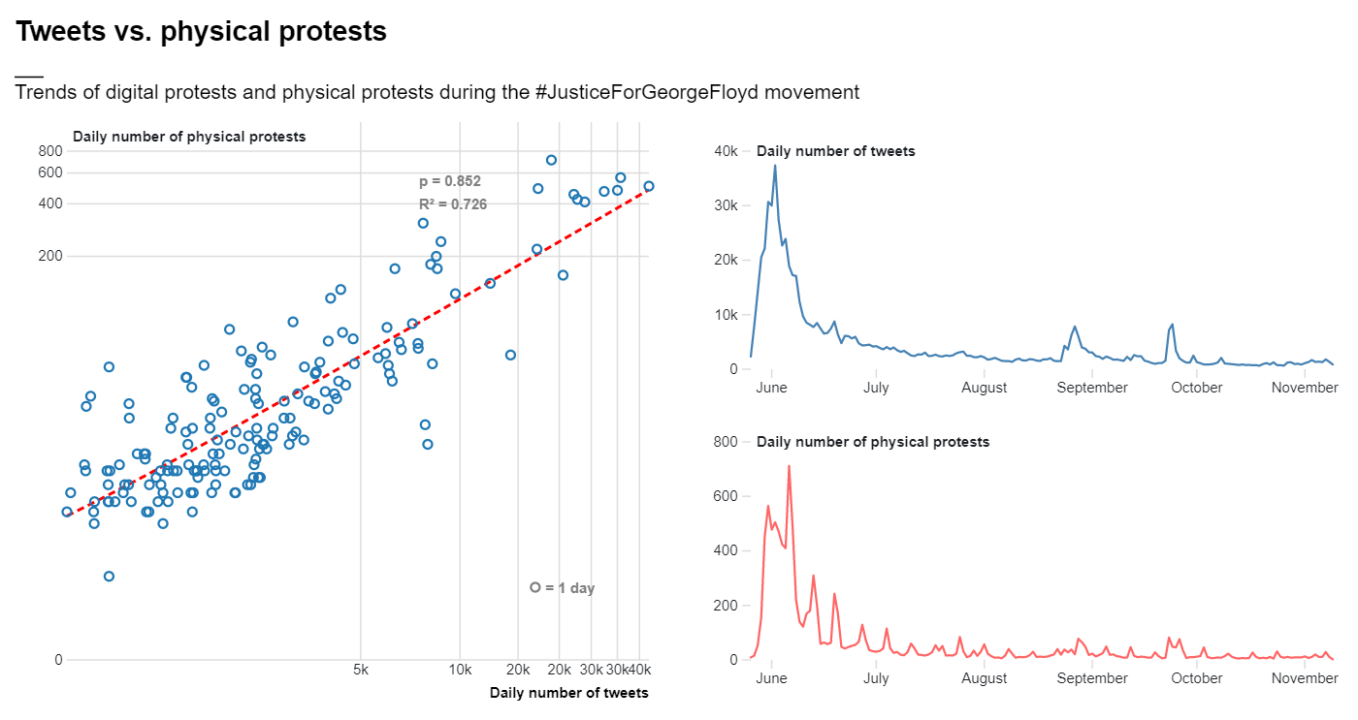
Notes:
In this slide you see the result of aggregating point data describing instances of hashtag activism and physical protests in time and space at the national scale
On your right, you have time series illustrating the temporal patterns of both hashtag activism (measured in number of tweets), and physical protests.
On your left you have a scatterplot illustrating the relationship between daily number of physical protests and daily number of tweets at the national scale
It can be observed that, at the national scale, hashtag activism bears a very strong positive relationship with physical protest activity. On days where people protested more on social media, people also protested more in the street, and vice versa. In the case of #JusticeForGeorgeFloyd, people used Twitter to express outrage about events of police brutality and to organize physical protests (CITE). During protests, more acts of police brutality were documented and shared on Twitter (CITE), which could have led to yet more protests and to more people showing up to protests, and so on.

Slide 24
Notes:
This trend can be modelled by a power regression function represented by the red dashed line, where y is the number of physical protests that take place on a given day and x is the number of social movement tweets that are posted on a given day. This model is considerably accurate, with a Pearson regression score of 0.852 and an R2 score of 0.726.

Slide 25
But… is this true in space as well?
Notes:
While this model provides useful insight into the temporal relationship between hashtag activism and physical protest, it cannot answer whether this relationship exists in space as well. That is, if an increase in hashtag activism in absolute is associated with an increase in physical protest counts in absolute, does an increase in hashtag activism in a particular location relate to an increase in physical protest counts in that particular location as well?

Slide 26
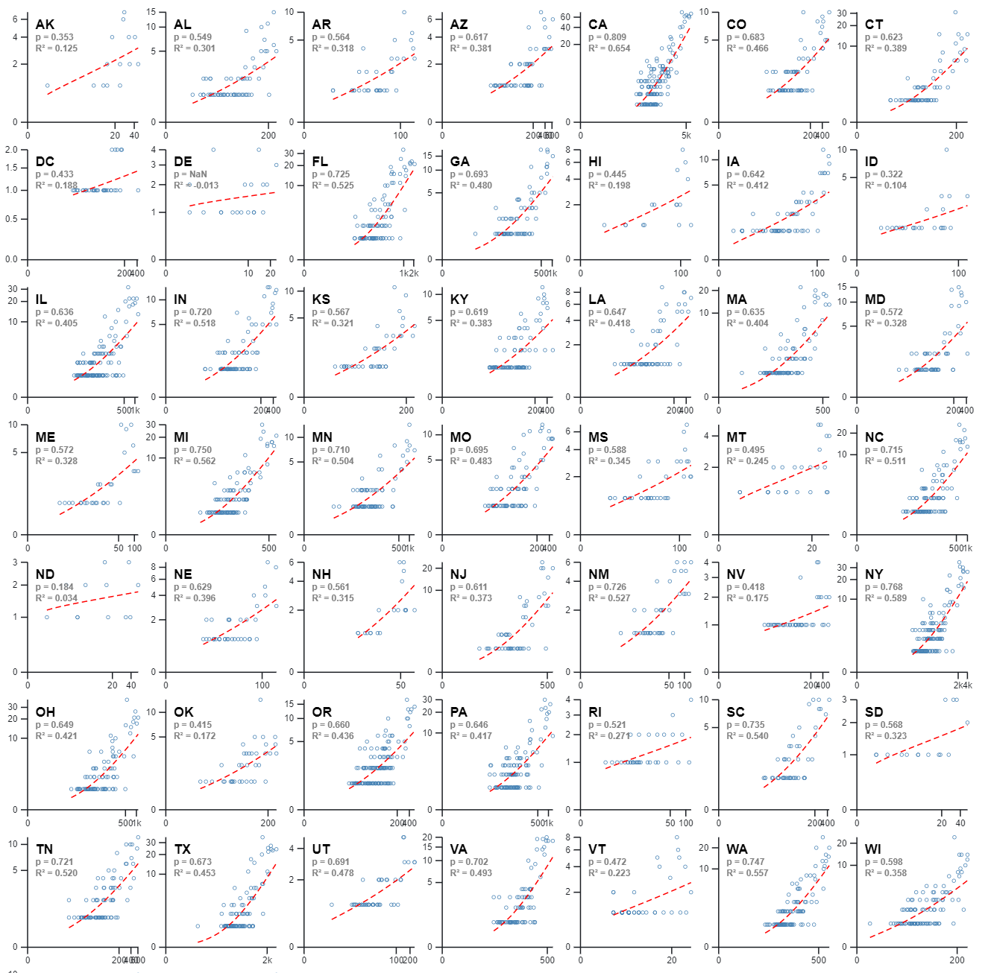
Median Pearson r = 0.74 Median r2 = 0.55
State Level
Notes:
In order to answer this question I aggregated physical protest counts AND social movement tweet counts both in time and in space (i.e. at the state level).
In this slide you can see the temporal and statistical relationship between daily number of physical protests and daily number of tweets as scatter-plots for each of the U.S.’s 51 states.
From this figure it is evident that the pattern previously observed at the national level also exists at the state level. As such, in spite of the existence of a few outliers, the relationship between hashtag activism and physical protest counts in each state is described by a strong positive correlation. Across 51 states, increased twitter activity on a specific day almost always results in increased counts of physical protests.
Additionally, similarly to the trend observed at the national scale, the relationship between state-level hashtag activism and physical protest counts can be modelled by a power regression function (yn=mxbn), represented by the red dashed line in each subplot, where y is the number of physical protests that take place on a given day in a given state and x is the number of social movement tweets that are posted on a given day in a given state. Considering the fact that we are modelling complex human behaviours, such models are fairly accurate,
with a median R2 value of 0.55 across 51 states, and 37 states that are associated with R2 values greater than 0.5.

Slide 27
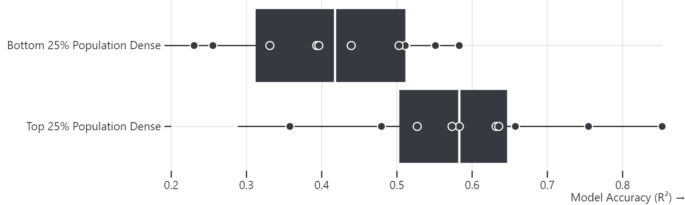
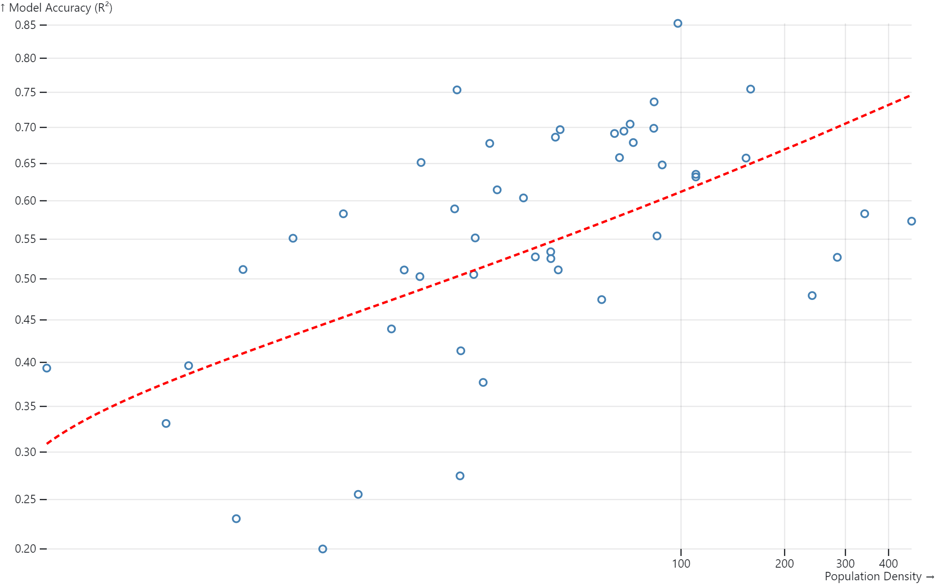
Notes:
Interestingly, across the top 25% most densely populated states, these models score even higher.
In contrast, the states where this relationship is weakest are also the more rural and least densely populated states (i.e. HI, ID, ME, ND, AK, AR, DE, MS, SD, WY, VT)

Slide 28
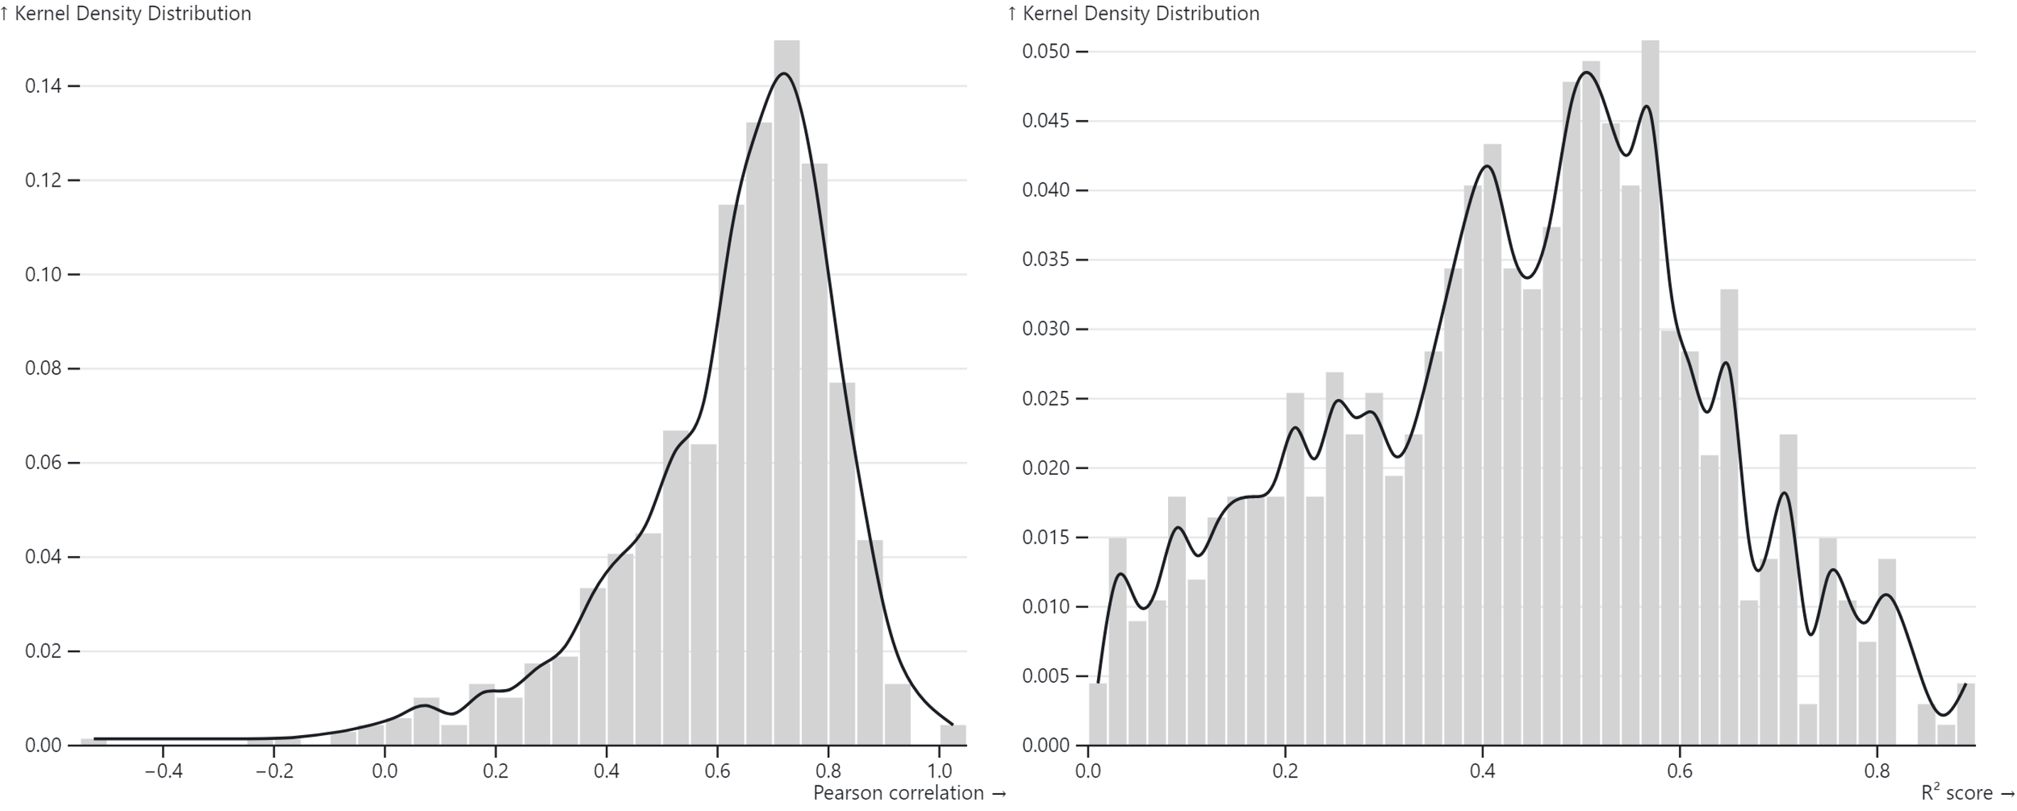
County Level
Notes:
Following the same methodology, I disaggregated the spatial scale further and investigated the temporal relationship between hashtag activism and physical protest counts at the county level. Once again, I modelled this relationship as a power regression function (yn=mxbn) for each of the U.S.’s 3006 counties. Results from this analysis are illustrated in this slide, where the obtained Pearson correlation values and R2 values are illustrated as kernel density distributions due to the large number of counties analysed. This figure shows that, on average, county level correlation values are positive and relatively high. However, the right subplot also shows that while a power regression is accurate in a majority of counties, there are also a substantial number of counties that do not fit this model.

Slide 29
Why this variance in the strength of this relationship?
Notes:
So why is it that at smaller scales such as county level, this relationship is not always so strong?
One reason for this could be the lack of data-points available in some less densely populated counties.
Another could be the existence of a social media bias, meaning that in some counties people use social media platforms other than twitter

Slide 30
Why this variance in the strength of this relationship?
#hashtag activism vs. physical protest trade-off:
Notes:
Another explanation for this variance is the existence of a trade-off between physical protest and hashtag activism, where in some counties people use physical protest to greater extents, while in other counties people may use hashtag activism more instead.
Modelling the relationship between hashtag activism and physical protest at the county level can provide unique insight into which locations experience synergy across digital and physical activism mediums, and which do not. That is, it can help to identify which counties have activist groups that mobilize both digitally and physically, and thus where physical protests can be expected if people are already protesting on social media. Essentially, such counties are likely to be those where the power regression model yields both a high Pearson correlation value AND a high R2 value.
This type of classification is visualized in the form of a bivariate choropleth map in this slide.

Slide 31
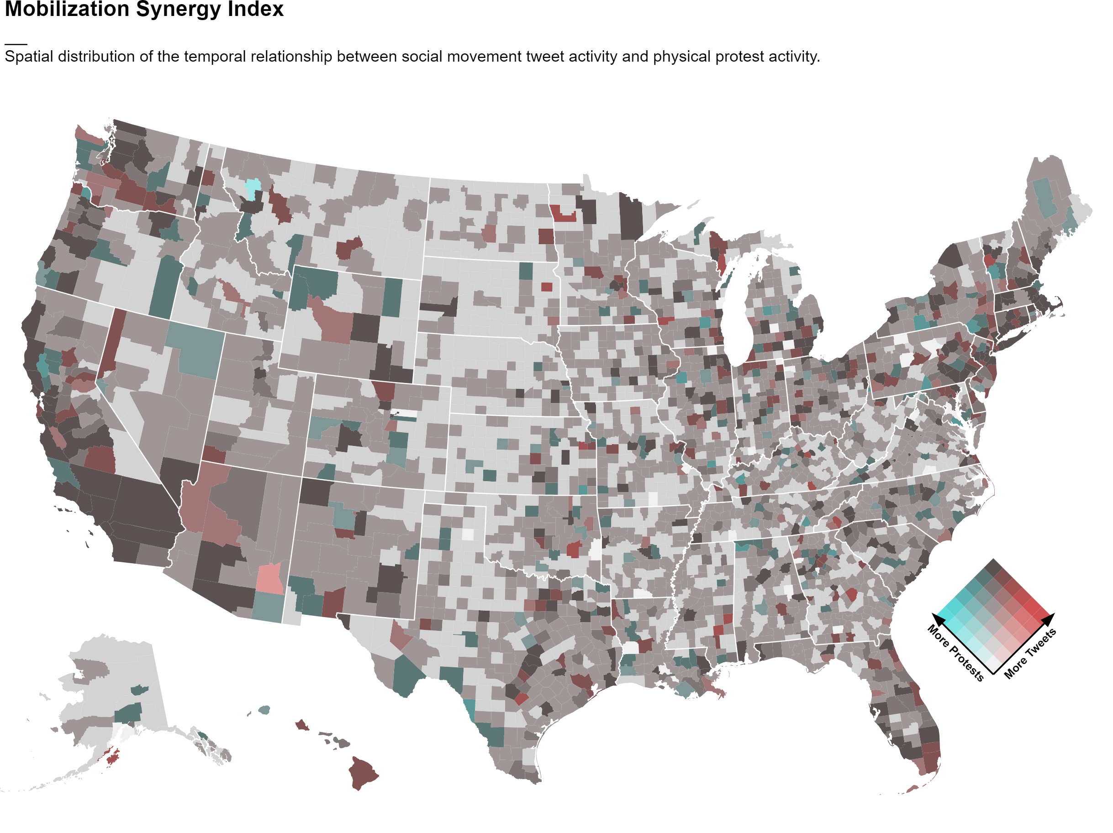
Mobilization Synergy Index (MSI)
Notes:
By combining the residual values, slope, and accuracy of the regression model for each county, we can make sense of this tendency in the form of a simple index: We call it the Mobilization Synergy Index (MSI).
The spatial distribution of this index is visualized here through a bi-variate choropleth map.
In this map, darker shades represent counties in which hashtag activism and physical protest are strongly related, and thus where people are likely to protest both digitally and physically on a given day.
In contrast, shades of blue represent counties where physical protests usually outweighs hashtag activism, and thus where people are more likely to protest physically on a given day.
Finally, shades of red represent counties where hashtag activism outweighs physical protests, and thus where people are more likely to protest digitally on a given day.
both policy makers and activists could gain valuable insight from this index. On the one hand, local policy makers could utilize it to understand how their communities mobilize in times of crisis, and become responsive to local demands accordingly. For example, if a specific county is categorized by the index as a county where people use hashtag activism disproportionally, this could be a sign for local policy makers to pay closer attention to social media platforms for understanding community needs.
On the other hand, activists could utilize the index to plan their mobilization efforts more efficiently and effectively. For example, by identifying counties in which people engage in hashtag activism intensely but do not mobilize physically, local activist groups could modify their strategies for physical mobilization so that more people show up at protests.

Slide 32
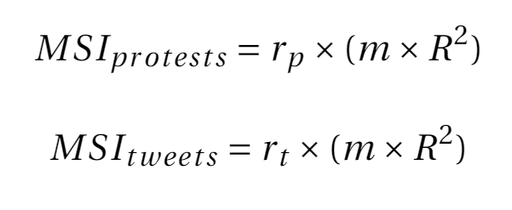
Mobilization Synergy Index (MSI)
proportion of positive residuals
model accuracy
slope
proportion of negative residuals
Notes:
By combining the residual values, slope, and accuracy of the regression model for each county, we can make sense of this tendency in the form of a simple index: We call it the Mobilization Synergy Index (MSI).

Slide 33
physical protests
= day
digital protests
Notes:
Such tendency can be understood with the help of residual values resulting from each county’s power regression model. Let’s look at this graph which represents the temporal relationship between physical protest and digital protest for an imaginary county. Here, this relationship is very strong: when a number of people engage in hashtag activism in this county, a proportional amount of people also engage in physical protest in the same county.

Slide 34
physical protests
slope ~ 1
r2 ~ 1
positive residual
negative residual
digital protests
Notes:
In statistical terms, in this county the relationship between hashtag activism and physical protest is modelled by a regression function which has a slope that is close to 1, a high r2 score, and an equal proportion of negative and positive residuals (the difference between predicted and observed values).
- In other words, the number of positive residual values represents the number of data-points (i.e. days) in which physical protests were underestimated by the regression model, and thus where the proportion of physical protests was larger than that of social movement tweets. Instead, the number of negative residual values represents the number of data-points in which physical protests were overestimated by the regression model, and thus where the proportion of physical protests was smaller than that of social movement tweets.

Slide 35
physical protests
physical protests
<
digital protests
digital protests
Notes:
But what if in another imaginary county, the relationship looks like this. In this case, the proportion of negative residuals is HIGHER than the proportion of positive residuals. In other words, in this county tweet activity is in general disproportionately intense over the course of the social movement.

Slide 36
physical protests
physical protests
>
digital protests
digital protests
Notes:
In contrast, here we have another imaginary county where the proportion of positive residuals is HIGHER than the proportion of negative residuals. In other words, in this county physical protest activity is in general disproportionately intense over the course of a social movement.

Slide 37
But… what happens first?
Notes:
Political mobilization processes such as hashtag activism and physical protest are complex in nature as they occur in uncontrolled environments where a multitude of influences are at play
For this reason, it is virtually impossible to establish causal relations between them. Still, some insight can be generated regarding the way in which these two processes may influence each-other in space and time.

Slide 38
Lagged Regressions
Directionality between xt and yt
In short: fit power regression model n times using yt data and x(t +- n)
t = current day
|n| = maximum number of time lags
Notes:
One way to study the directionality between two time series, xt and yt, is to identify lags of x that may be the best predictors of yt.
In the case of hashtag activism and physical protests, this method involves fitting a power regression model n times using data on physical protest counts at time t and data on tweet counts at n different time lags. That way, the time lag at which the optimal correlation is obtained can be found.
where |n| is the maximum number of time lags.

Slide 39
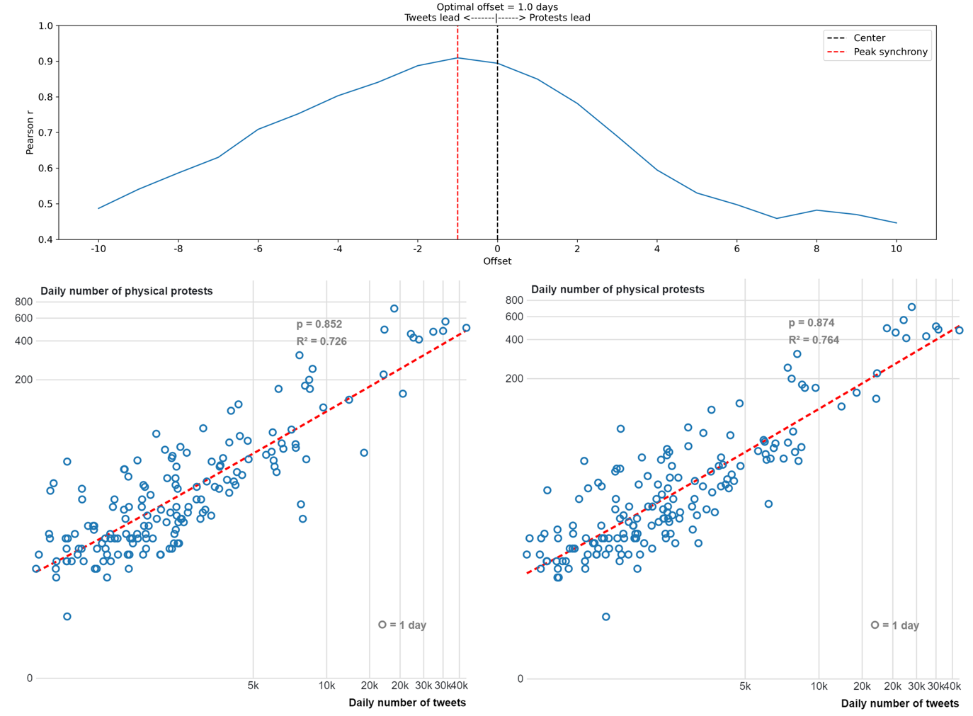
National Level = Tweets lead by 1 day
Optimal time Lags
Notes:
In this slide, you can see the results of performing lagged regressions on national level data using a maximum time lag of n=10.
This figure shows that the optimal Pearson correlation value and R2 score is obtained when hashtag activism (i.e. daily number of tweets posted) leads physical protests by one day. In other words, at the national scale and during the case study of #JusticeForGeorgeFloyd, the best predictor of tomorrow’s physical protest activity is the number of social movement related tweets posted today.

Slide 40
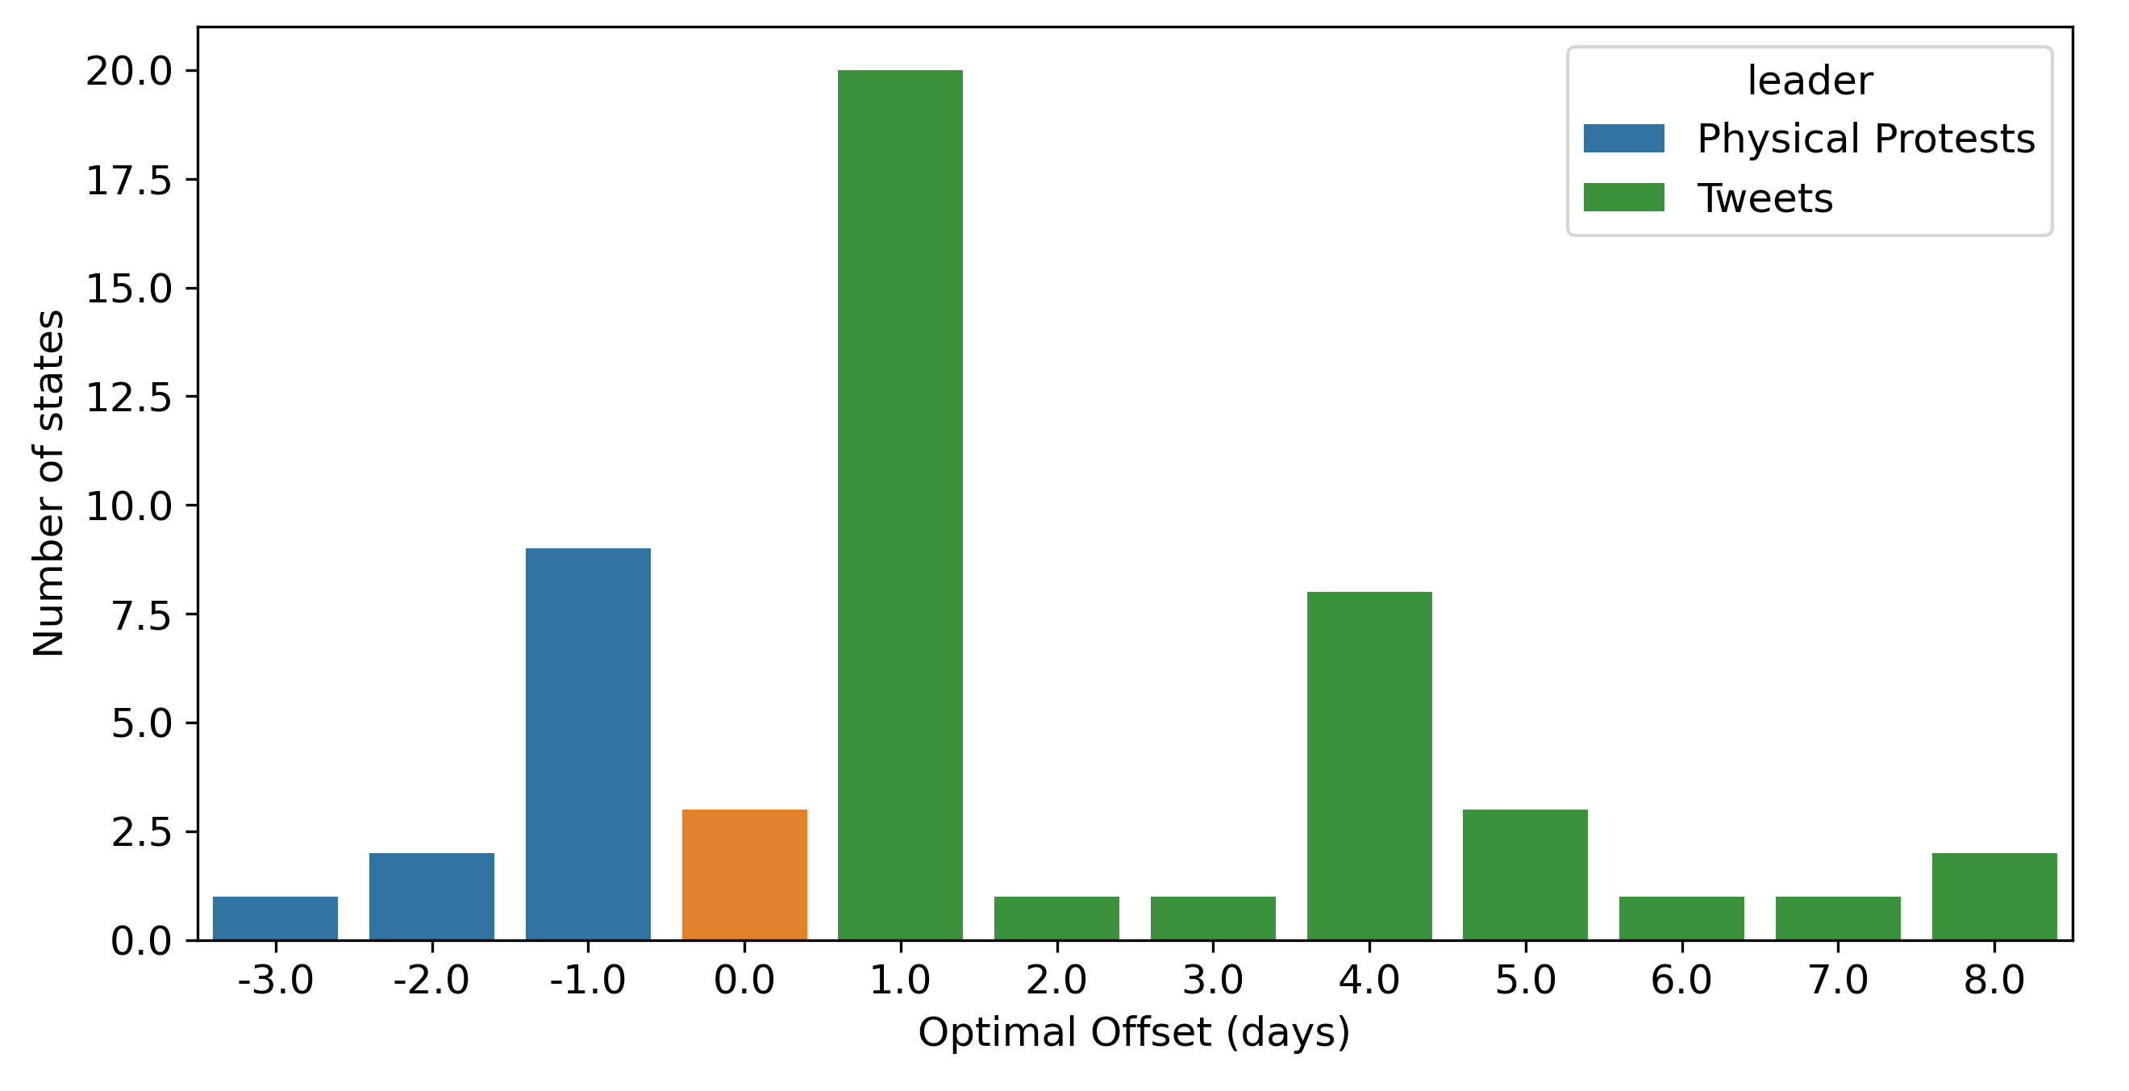
National Level = Tweets lead by 1 day
Optimal time Lags
State level = Tweets lead by: - 1 day in 20 states - 1+ days for 41 states
Notes:
at the state level: in 41 out of 51 states the optimal Pearson correlation value is obtained when tweets lead by one or more days. For 20 of those states, the optimal Pearson correlation is obtained with a time lag of one day. These results are in agreement with other studies that have argued for a one day time lag between tweets and physical protest.

Slide 41
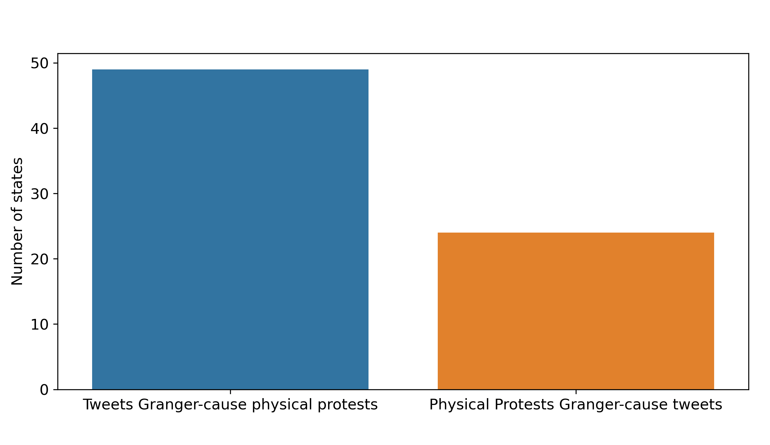
Granger Causality = Tweets Granger-cause physical protests in 49 out of 50 states Physical protests Granger-cause tweets in 24 out of 50 states
State Level
Notes:
To further investigate this pattern I performed granger causality analysis: a statistical hypothesis test used for determining whether one time series is useful in forecasting another
Strikingly, it was found that in 49 out 50 states tweets granger cause physical protest, whereas only 24 out of 50 states hint to the opposite relationship

Slide 42
Predicting physical protest counts from instances of hashtag activism?
Deep Learning Approach:
Long Short Term Memory (LSTM) neural network
+ Vector Autoregression (VAR) model
Notes:
Based on this, can we use data on instances of hashtag activism to predict future physical protest counts?
In this research, we developed and tested two deep learning architectures to predict future counts of physical protests based on past values of both physical protests and tweet counts:
a simple Long Short Term Memory (LSTM) artificial neural network
as well as a LSTM artificial neural network combined with a Vector Autoregressive (VAR) model (LSTM VAR).
Each model was trained and fine-tuned on aggregated national level data, and was used to predict physical protest counts at the national and state-level.

Slide 43
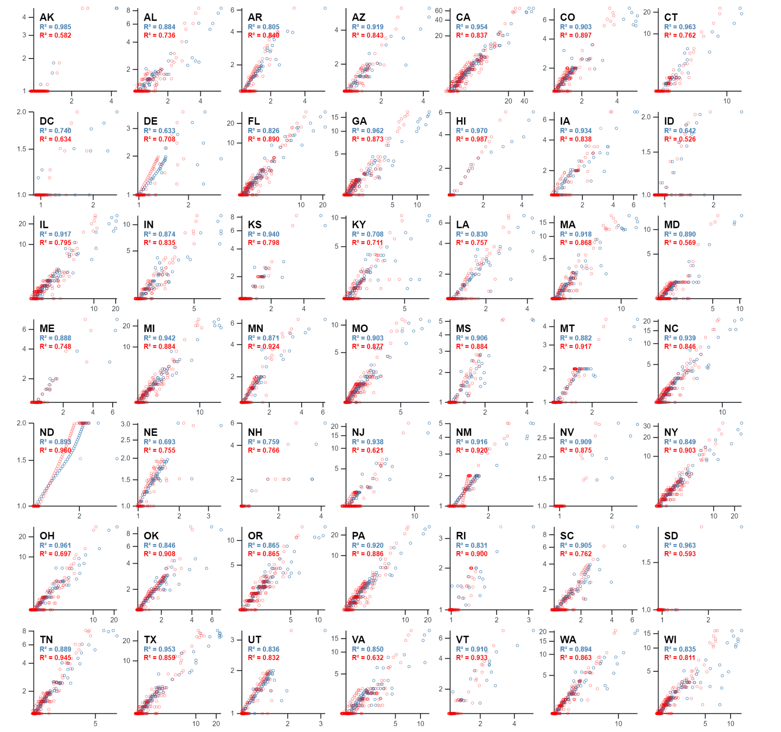
State Level
= LSTM
Median r2: 0.79
= LSTM + VAR
Median r2: 0.87
Notes:
Here, we illustrate state-level model performance results, where we plot state-level predicted physical protest counts on the x-axis against actual physical protest counts on the y-axis for the LSTM (blue) and LSTM VAR (red) models.
We can observe that both models were successful at accurately predicting daily physical protest counts for each state.
In all cases, both models were able to generalize the temporal patterns learned at the national level to predict future instances of physical protest based on past instances of physical protest and tweet activity at the state level. In general, the LSTM VAR model scored much higher than the simple LSTM model.

Slide 44
#hashtag activism and Legislative Action: Evidence from #JusticeForGeorgeFloyd
Notes:
Let’s focus on the second main outcome of this research: What is the relationship between location-based hashtag activism and legislative action?

Slide 45
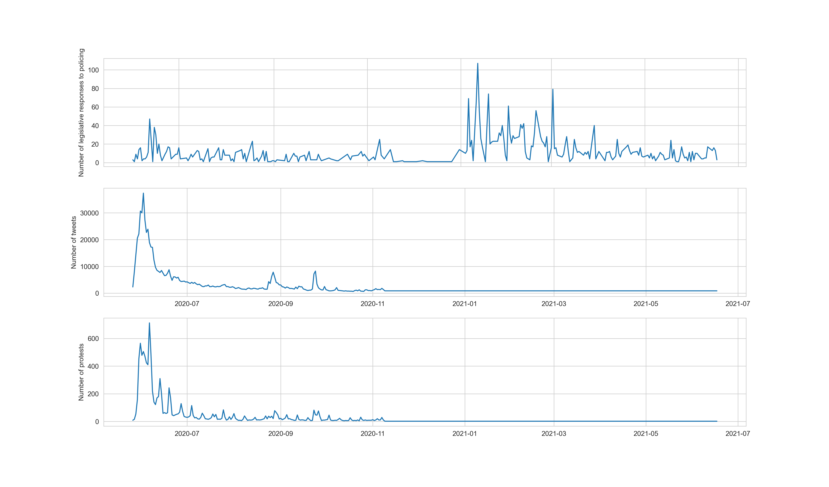
Legislative Responses
Tweets
Physical protests
Notes:
In this slide you can see three time series associated with the #justiceforgeorgefloyd social movement: the physical protests on the bottom chart, the hashtag activism in the middle chart, and the legislative responses related to policing in the top chart

Slide 46
Legislative Responses
Tweets
Physical protests
Notes:
From this figure, we can see that the highest counts of legislative responses to policing took place many months after peaks of hashtag activism and physical protest activity.

Slide 47
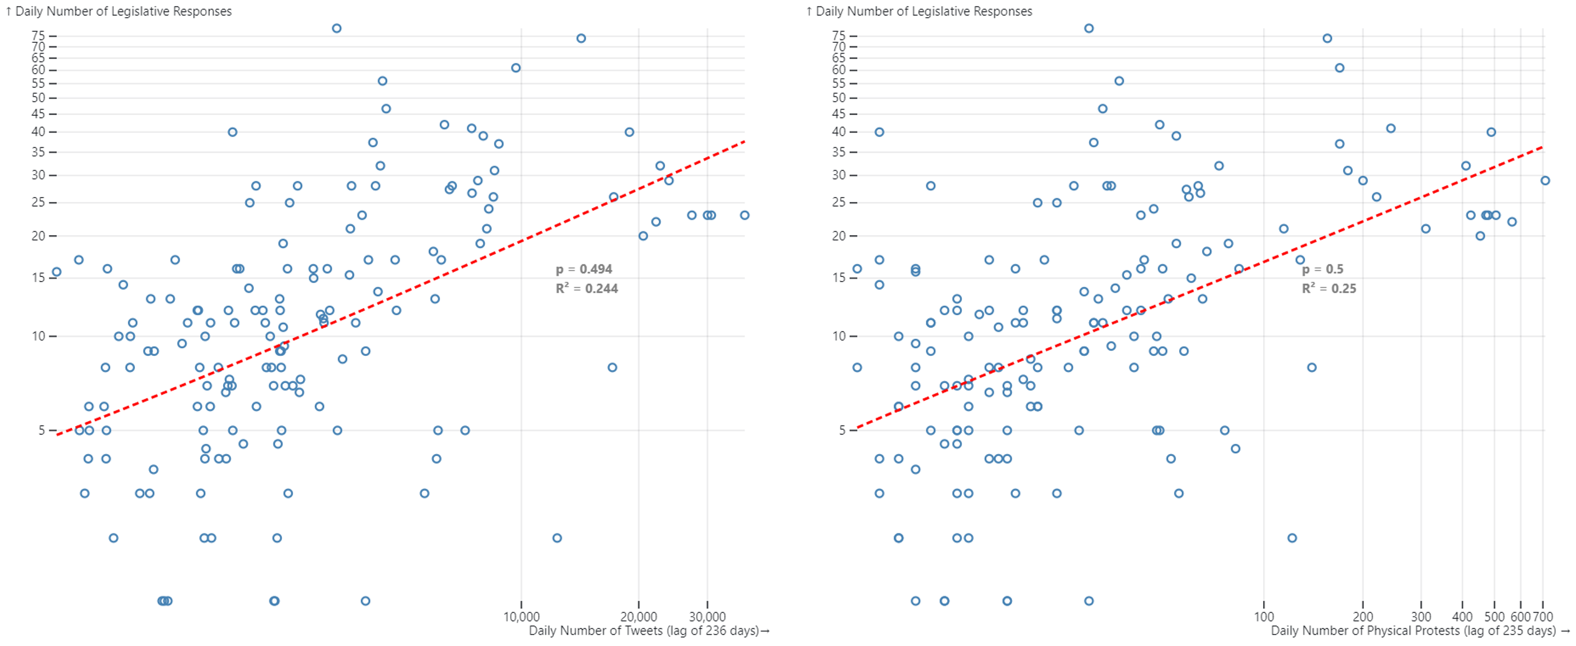
Optimal time lags: National Level
Tweets: 236 days before legislative responses
Physical Protests: 235 days before legislative responses
Notes:
Similar to the analysis conducted between hashtag activism and physical protest, we performed lagged regressions between each of hashtag activism and physical protest and the daily number of legislative responses to policing. The results are presented in this slide, where the highest correlation between legislative responses and hashtag activism was found with a time lag of 236 days and the highest correlation between legislative responses and physical protest was found with a time lag of 235 days.
In other words, at the national scale and during the case study of #JusticeForGeorgeFloyd, it was found that the best predictor of the number of legislative responses on a given day is the number of social movement related tweets posted at 236 days prior to that day or the number of physical protests that took place 235 days prior
This is intuitive, and further confirms the one day lag that was found to exist between physical protests and hashtag activism.

Slide 48
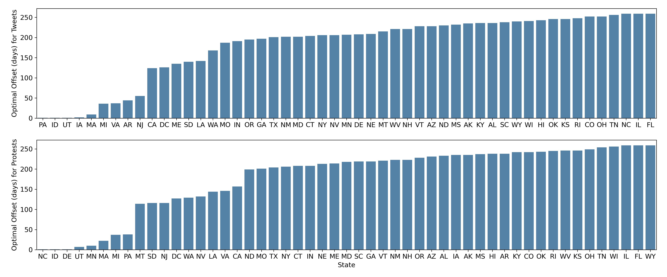
Optimal time lags: State Level
Average time lag: 179 days
→ Why do some states respond faster than others?
Notes:
At the state level, it was found that there is an average time lag of 179 days between the time in which hashtag activism/physical protest peaks and the time in which the majority of legislative responses occur.
But we also observe that there is a great variability across states, with regards to how much time goes by between peaks of physical protest/hashtag activism and peaks of legislative responses.
In fact, compared to other states, some states experienced the majority of their legislative responses much closer in time to when they experienced the highest peaks in hashtag activism and physical protest.
While this goes beyond the scope of this research, we may ask ourselves why do some states respond faster than others?

Slide 49
Research Impact
Computational Framework
Time: hashtag activism physical protest
Space: hashtag activism physical protest
Deep learning application → social movement research
Mobilization Synergy Index (MSI)
Hashtag activism: political consequences beyond physical protest
→ Space: hashtag activism → legislative action
Notes:
To the best of my knowledge, this research represents the first national-level quantitative study aimed at measuring the temporal relationships between hashtag activism, physical protest activity, and legislative action, at various spatial resolutions. In doing so, this research adds several potential scientific contributions to the field of social movements research.
1. This research offers a computational framework that leverages open source social media data and physical protest data which are available for most countries in the world, thus allowing the results of this study to be scaled to other social movements in other parts of the world.
2. This research contributes additional empirical evidence that hashtag activism is strongly related tophysical protest activity through time, and that a unidirectional relationship between hashtag activismand physical protest may exist.
3. This research contributes new empirical evidence that hashtag activism and physical protest activity are not only related through time, but also across the spatial dimension.
4. This research provides evidence that deep learning frameworks can be used effectively for the predic-tion of physical protest activity during social movements based on the raw count of relevant socialmedia posts. For obvious ethical implications, however, the model developed here will not be shared publicly.
5. This research offers theMobilization Synergy Index, a novel index that makes use of simple statistical concepts to provide an explanation as to why some geographical areas exhibit a weaker temporal relationship between hashtag activism and physical protest activity. Such index can serve as a tool for local policy makers and activists to understand how their communities mobilize in times of crisis, and thus improve the effectiveness of local political and activism strategies.
6. This research demonstrates that hashtag activism may have real political consequences that go beyond political mobilization for physical protest. As such, this research offers novel empirical evidence that the intensity of hashtag activism today can provide insight into the significance of future political action in terms of new legislative responses. Additionally, this research provides statistical evidence that this trend may also be related to space, where state level hashtag activism informs state level legislative responses

Slide 50
Ethical Considerations
Outcome of this research: exciting BUT problematic
Social impact could be damaging:
law enforcement → predict location of physical protests ☹
Who should responsible for mitigating against these impacts?
Policy makers
Social media companies (i.e. Twitter)
How to mitigate: boundaries to access
regulatory policies: limit the use of location data from social media by law enforcement
usage policies: limit access to specific data attributes for law enforcement agencies
activist groups can safeguard their opportunity to lawfully voice their concerns for more progressive policies through physical protest
Notes:
Through this research, the analysis and modelling of geo-located social media data has taught us that the way in which we use social media in times of crisis can be a strong indicator of where, when, and with what intensity we choose to take the streets and protest against injustice.
This fascinating research outcome is exciting to discover. At the same time, however, this research out-come is worry-some because we live in a world where powerful institutions such as law enforcement agencies often harness their power to oppress the most vulnerable and disenfranchised groups.
On this basis, the social impact of this research may not turn out to be as exciting as the scientific impact of this research, where the models and insights of this research could equip law enforcement agencies to respond to physical protests more rapidly and to use more oppressive tactics against protesters.
As scientists, it is our responsibility to conduct and communicate novel scientific research, but we have little power at our disposal to ensure that our research is used solely for the betterment of society. This task is the role of policy makers and (to a lesser extent) private companies, who do have regulatory and veto power at their disposal.
There are effective ways in which policy makers and social media com-panies can mitigate against unethical applications of this research. With regards to law and policy making,regulatory policies can be put in place for law enforcement agencies to respect the personal privacy of indi-viduals. For example, such policies could limit the use of location data from social media by law enforcement agencies for the purpose of tracking demonstrations and ongoing physical protests.
With regards to social media companies such as Twitter, usage policies can be put in place to limit access of specific data attributes to law enforcement agencies. For example, just like Twitter has recently increased access to its data for aca-demic purposes, it may limit access to its data for law enforcement purposes (i.e. not provide location in-formation to law enforcement developers).
By creating boundaries to access, the use of data for social good can be ensured and activist groups can safeguard their opportunity to lawfully voice their concerns for more progressive policies through physical protest.

Slide 51
Questions
Feedback
Criticism
.
.
.
?

Slide 55
Limitations
External Validity
Spatial Resolution
Restrictive Legislative Data
Notes:
1. External validity: due to the analysis of a single case study, the results of this research could only bevalid for the specific case of #JusticeForGeorgeFloyd and may not be observed for other social move-ments in other parts of the world. Future research may address this limitation by implementing theproposed experimental framework to the case of other relevant social movements in other geographi-cal areas.
2. Spatial resolution: While this research makes use of a large data-set with considerable geographicalcoverage, the spatial resolution of this data is still limited. For this reason, this research could not con-duct analysis for sub-county level patterns in hashtag activism and physical protest activity (e.g. theneighborhood or precinct level). This limitation is difficult to address, as the availability of sub-citylevel geo-located social media data is scarce due to a number of ethical considerations (e.g. privacy).Nonetheless, future research could address this limitation by using sources of social media data thatcome with improved spatial resolution.
3. Restrictive Legislative data: Due to the lack of a concerted effort to collect local level (i.e. county-level or city-level) legislative responses to policing, this research could only analyze state-level datarelating to legislative action. Future research making use of local-level data on legislative responsescould greatly improve this limitation and provide more accurate insight into the impact of hashtagactivism on legislative responses. With such analysis, a similar index to theMobilization Synergy Indexproposed in this research could be developed.

Slide 56
National-level physical protest count predictions (testing time-frame)
National-level physical protests and tweet counts by day (testing data)
Final
LSTM + VAR
National-level physical protest counts and tweet counts by day (training data) fed as 7-day windows
State-level physical protest count predictions (full time-frame)
State-level physical protests and tweet counts by day (full dataset)
Final
LSTM
Tuned-model parameters
Vector Auto Regressive (VAR) model
Long Short Term Memory Neural Network (LSTM)
Fitted values from VAR
National-level physical protests and tweet counts by day (validation data) as 7-day windows
Simple LSTM
LSTM + VAR
Validation and hyperparameter tuning
Modelling
National-level physical protest count predictions (next day)
Training
Validation
Testing
Final predictions

